Slide 1
Asynchronous JavaScript #2
JORDAN SZALONTAI – 2020. 03. 23.
CONFIDENTIAL | © 2020 EPAM Systems, Inc.

Slide 2

Who am I?
Software Engineer at EPAM Systems
Working at EPAM since August 2018
JavaScript (UI) developer
Graduated at the University of Debrecen (Computer Science BSc)
Available for questions at Jordan_Szalontai@epam.com

Slide 3

Agenda
1.
ES6
2.
Promises recap
3.
Working with promises
4.
Generator functions
5.
Async / await

Slide 4
es6

Slide 5
What is ES6?
EcmaScript 6 / EcmaScript 2015
New standard of the language
Bunch of new goodies & syntax sugar

Slide 6
ES6 (const)
Block (local) scope
Can not be redeclared
Can not be changed through reassignment
Preferred way of using variables (if you really don’t change them)
vs.

Slide 7
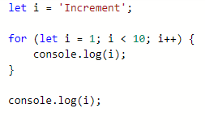
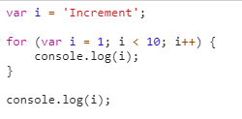
ES6 (let)
Block (local) scope
Can be changed through reassignment
Use if you change the value of the variable
vs.

Slide 8
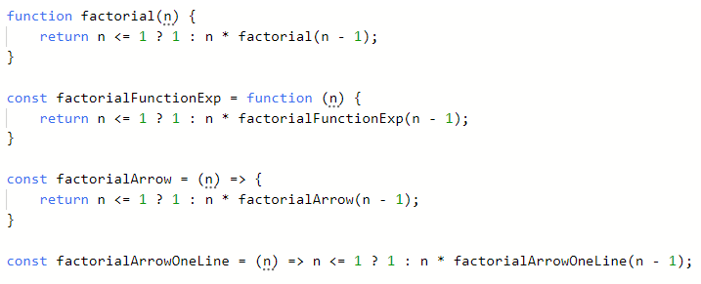
ES6 (arrow functions)
The this context variable of the arrow functions is equal to their „parent” context (they do not create a new one)
The functions call, appy, bind work the same as expected
If the function only expects 1 argument, parentheses can be omited
If you don’t write the „body” of the function, it returns the expression after the arrow

Slide 9
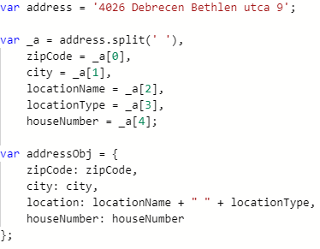
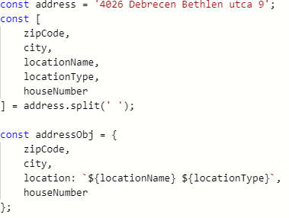
ES6 (destructuring)
vs.

Slide 10
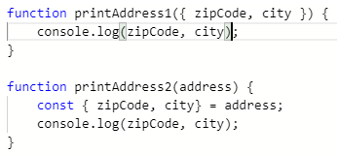
ES6 (destructuring)
Most common example of destructuring is the following: A function receives an object as an argument, and it only needs some part of the object to work

Slide 11


ES6 (spread operator)
vs.

Slide 12


ES6 (spread operator)
vs.

Slide 13
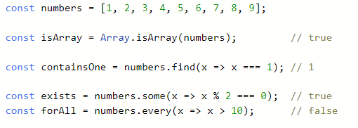
ES6(+) Arrays
Bunch of new array methods were introduced (not all in ES6, but basically ES6 and above)
For more array methods please visit: https://developer.mozilla.org/en-US/docs/Web/JavaScript/Reference/Global_Objects/Array#

Slide 14
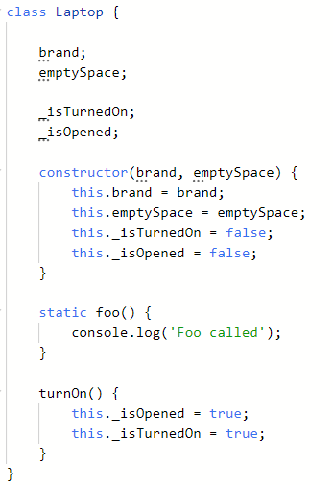
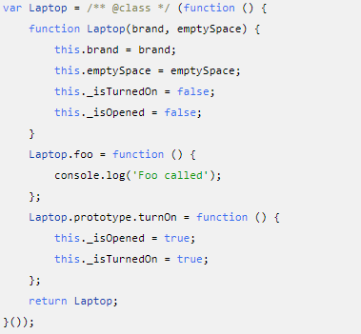
ES6(+) Classes (finally)
Hoisting does not apply
Everything is almost the same as with constructor functions and IIFEs

Slide 15
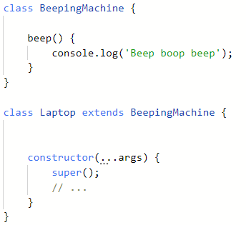
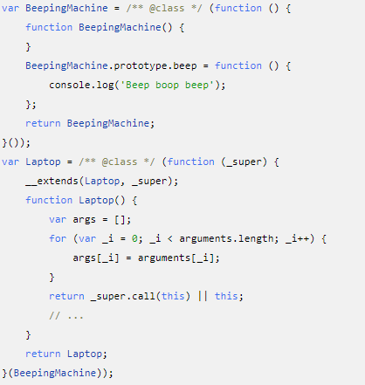
ES6(+) Classes (finally)
Inheritance is also the same, but looks more readable
This is a pre-defined function for doing the prototype stuff

Slide 16

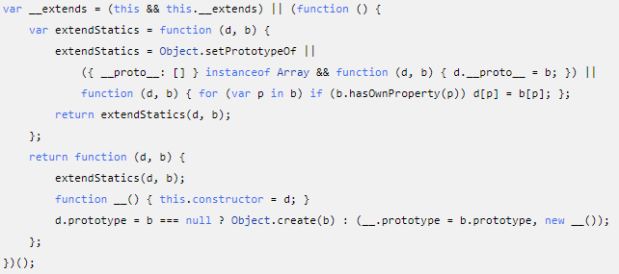
_extends
Deals with prototypes and setting the constructor reference
You don’t need to know this, as this is given implicitly and is transpiled from ES6 to ES5

Slide 17
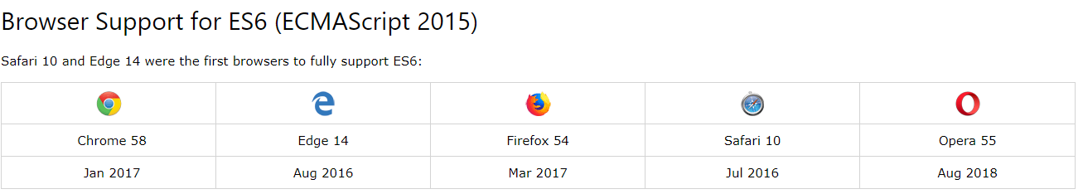
ES6 (extras)
All transpiled code was provided by https://www.typescriptlang.org/play
Please visit:
https://www.w3schools.com/js/js_es6.asp
http://es6-features.org

Slide 18
Promises recap

Slide 19
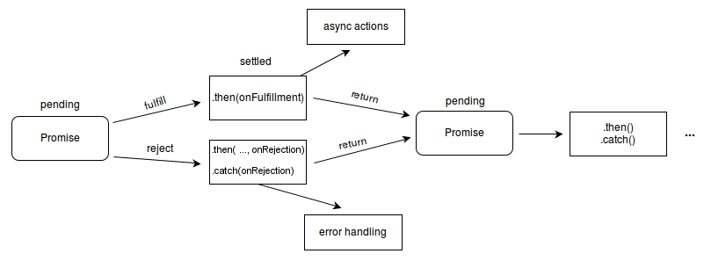
Promises - Recap
A promise is an object representing the eventual completion or failure of an asynchronous operation
Usually HTTP communication with servers is represented with promises (fetch API)
A promise can be anything NOT ONLY HTTP communication
Has 3 states:
Pending
Resolved
Rejected
https://developer.mozilla.org/en-US/docs/Web/JavaScript/Reference/Global_Objects/Promise#

Slide 20

Promises - Recap
ES6 implements Promise object natively
pre ES6 has polyfills or other Promise libraries
Promises are objects representing a potential value, not the value itself

Slide 21


Promises – Recap – How to create a Promise?
Promise constructor
Promise.resolve()
Promise.reject()

Slide 22
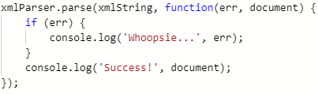
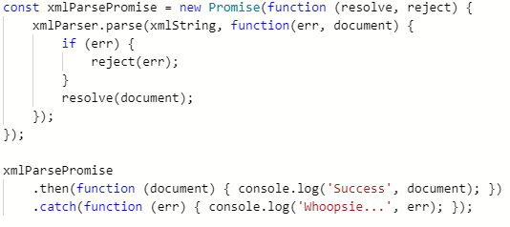
Promises – Recap – How to create a Promise ... from a callback?
↘

Slide 23
Working with promises

Slide 24
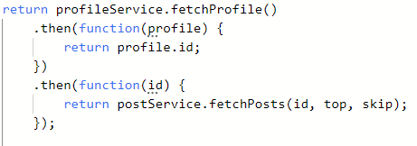
Working with Promises
A promise returns a Promise object,
The functions then and catch also return a Promise object
Promises can be chained one after an other, creating a Promise chain, these Promises will try to execute one after another, if any Promise in the chain rejects, the chained catch will execute. (If there is no catch the result will be a rejected Promise)

Slide 25
Parallel Promises
When two resources are not dependent
There can be other metadata retrieved an object, which is not so important to look at on the first load of the data
Processing big array of data in chunks
Retrieving pages of entities
Etc.

Slide 26
Parallel Promises
Promises have a native method called all
All takes an array of Promises and resolves in an array of the corresponding values
If any Promise rejects, the all Promise rejects
Used often, since an array of entities can be mapped to an array of Promises (e.g. based on their ID, fetch additional metadata)
Has the risk of rejecting^{1,2}
1 – Usually if one of the Promises reject it can mean 2 things: a) we messed up something (Cannot read property ’foo’ of undefined) b) the resource/backend is in a bad shape 2 – If the risk is bigger (e.g. Using a third party API call with an API call to application backend) not using Promise.all can be more benefitial

Slide 27
Racing Promises
Promises have a native method called race
Race takes an array of Promises and executes them in parallel
The value that the first Promise resolves, will be the single result of the race¹
Not used in every-day-work, but can be used for timeouts to prevent very long calls, or if you need the same date from multiple sources
1 – If a Promise rejects before any could resolve, the race Promise will be rejected, but after the first Promise resolves, all rejects will be ignored, but will still happen
reject with 504 Gateway Timeout after 10 seconds
P₁
P₂
auto reject after 2 seconds

Slide 28
Working with Promises
Let’s take a look at some code!
Racing horses example
Blog example

Slide 29
Error handling
Each promise has its catch method, which will run, if there’s any Promise rejection in the Promise chain
Each then after the last catch will run no matter what happened
If you apply finally to your Promise chain, that will be the last thing to run
NOTE: Promises returned from the fetch API cannot (really) reject, the response has the ok flag, and status information

Slide 30
Generator functions

Slide 31
What is a generator function?
ES6 introduced a new way of working with functions and iterators
Functions usually „do stuff”, then they can return a value
A generator is a function that can stop midway and then continue from where it stopped¹
A function that behaves like an iterator
The „keyword” fot a generator is function* ²
1 – The this context of the function will be „remembered” 2 – Yes, there IS a star at the end of the word „function”

Slide 32
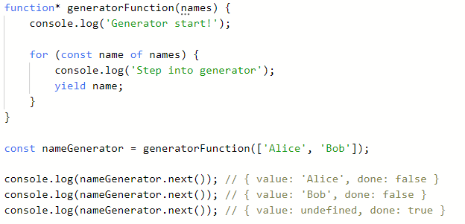
Generator function syntax
can recieve arguments
yield keyword „steps out” of the generator, and „returns” a value
acts like an iterator

Slide 33
Generator functions
Calling a generator function does not execute the body of the function, instead it returns an iterator object
Calling the next method of the iterator will start the execution of the generator function body until the next yield
and will return with an object that has a value property
the value property will be any expression after the corresponding yield
Writing return in a generator function will stop it¹
and will return an object that has a value property
the value property will be any expression after the return keyword
the done property of the object will be true
Yielding a value with the yield* keyword can delegate to an another generator function
1 – you can call the return or the throw function of the iterator (created by calling the generator function) as well, in order to stop a generator

Slide 34
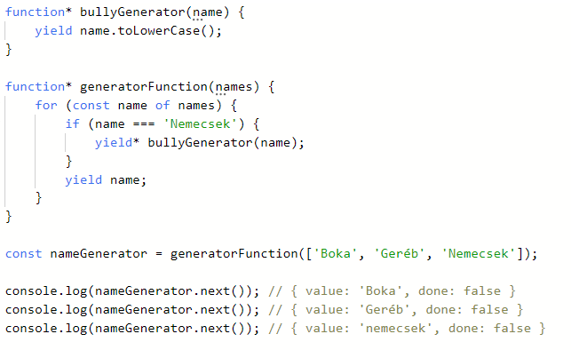
Delegate value to another generator
delegate with yield*
regular yield

Slide 35
Wait for promises with generators
Combining Promises and generators can be handy to make asynchronous code look like it’s synchronous
We can wait inside a generator until a Promise resolves
meaning we can write a special awaiter function that waits for a generator to complete
inside the generator we can yield Promises
this results in synchronous looking code

Slide 36
Wait for promises with generators
Let’s look at a quick example!

Slide 37
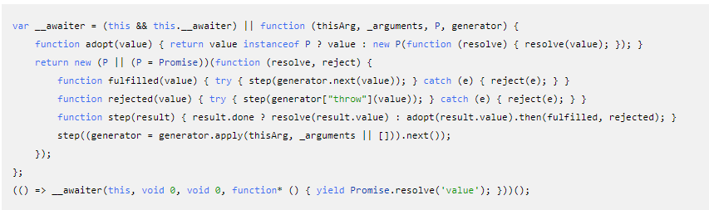
Wait for promises with generators – the „official way”
This code is the transpiled version of the following:
Thus you don’t (really) need to understand everything, just the concept

Slide 38
Async / AWait

Slide 39
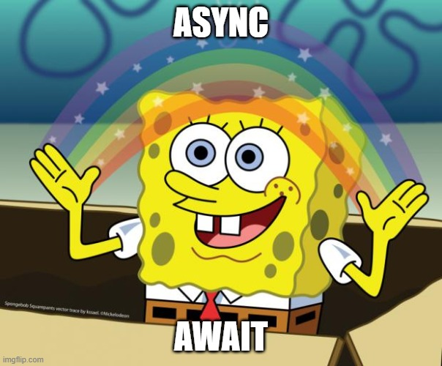
What is async / await
The main idea is to provide a syntax that deals with Promises in a synchronous way
Introduces 2 keywords: (async await, duh)
The async keyword can be present before functions
The await keyword can be used before any expression in an async function¹
1 – People like async await so much that they tend to wrap their whole code with an async IIFE, also „top level” await was proposed to the sandard

Slide 40
Good to know before using it
Every async function returns a Promise implicitly (like it or not)
The code execution will still be asynchronous
This is „just” syntax sugar, but code becomes super readable and easy to understand
This was introduced in EcmaScript2017¹
Writing less then and more await ☺
1 – Modern browsers and TypeScript support it out of the box

Slide 41
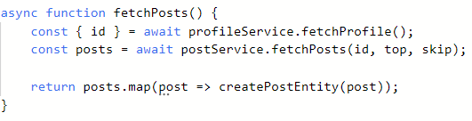
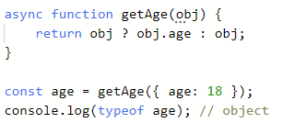
Using async/await
Using „real promises”
Using primitive values

Slide 42
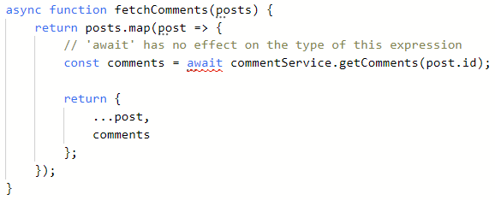
Using async/await with arrays
Higher order array functions (like forEach, map etc.) do not work with async/await as expected
simiply because their callback functions „confuse” the generator function they are wating in
this can be worked around

Slide 43
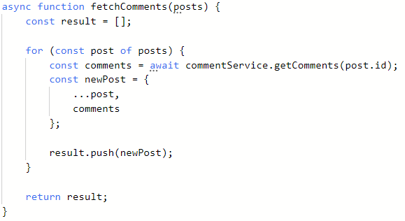
Using async/await with arrays
Higher order array functions (like forEach, map etc.) do not work with async/await as expected
simiply because their callback functions „confuse” the generator function they are wating in
this can be worked around

Slide 44
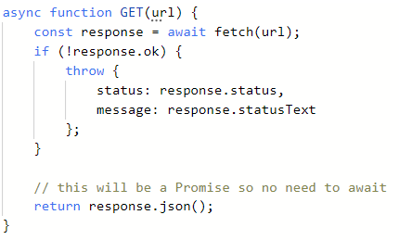
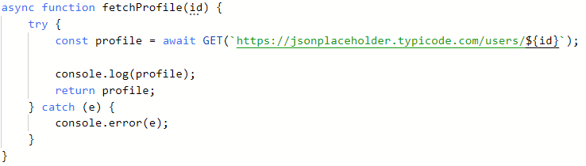
Error handling with Async/Await
The error handling can be aligned with the synchronous way of handing errors
try-catch-finally

Slide 45
Takeaway

Slide 46

Takeaway
Promises are powerful
Promises can be anything
There are lots of commonly used patterns / ways of working with Promises, it depends on the project and the use cases
Try to get used to ES6(+)
Generator function are rarely used in daily work, but they are the thing behind async/await

Slide 47
Takeaway
Useful links:
Promise:
https://developer.mozilla.org/en-US/docs/Web/JavaScript/Reference/Global_Objects/Promise
Generator function
https://developer.mozilla.org/en-US/docs/Web/JavaScript/Reference/Statements/function*
Async/Await:
https://developer.mozilla.org/en-US/docs/Web/JavaScript/Reference/Statements/async_function
https://www.youtube.com/watch?v=vn3tm0quoqE
Understanding the Event loop (how promises & things execute in browser)
https://www.youtube.com/watch?v=cCOL7MC4Pl0
Anything:
Google → javascript [type anything here] mdn → first result

Slide 48
Köszönöm a figyelmet!

